Slide 1
SIL3 relays with line & load monitoring
Safety relays for the process industry
Joachim Janik

Slide 2
Selling Story
Relay modules between control level and field level for energize to safe switching of plant parts in the process industry including line & load monitoring.
The products are certified by TUV NORD as "approved safety function" according the standard for functional safety EN 61508:2010.
Due to the diagnostic - and alarm output a permanent monitoring of open wire and load failures is possible.
We are offering the SIL3 relay with an extended temperature range up to 70°C for critical environmental conditions. It is certified for usage in explosive atmosphere.

Slide 3
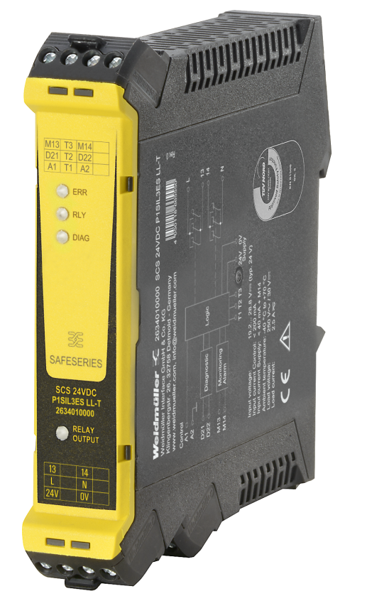


SIL3 relay with line & load monitoring Safety relay for the process industry
Tested with Honeywell Safety Manager
Integrated open wire detection and load monitoring
TUV certified as
„approved safety function“
Extended temperature range up to 70°C
Certified for usage in
Explosive atmosphere
UL approval for North America
Contact Person: Joachim Janik

Slide 4
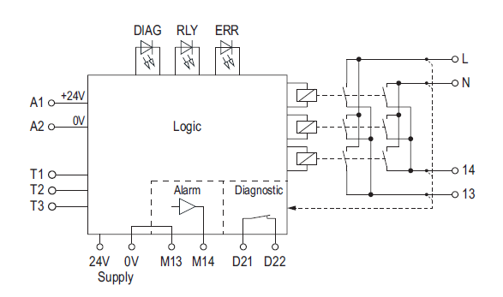
SIL3 relay with line & load monitoring Safety relay for the process industry
LED indicator for switching function, error message and supply voltage of „diagnosis“.
Test inputs for checking of the internal relay contacts.
Error output diagnostic and alarm.

Slide 5
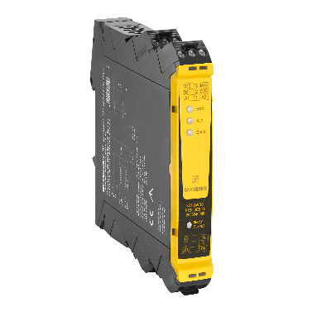
SIL3 relay with line & load monitoring Safety relay for the process industry
Differentiation from competitors
Extended temperature range up to 70°C
Diagnostic- and alarm output
Certified by TUV NORD as „approved safety function“
Product features
Customer benefit
Open wire detection and load monitoring
Usage in explosive atmosphere
Permanent monitoring of the load and the wiring of the system in not operating mode. Error message due to additional diagnostic and alarm output.
The IEC EX / ATEX certification for all markets confirms, that the special technical requirements for explosion protection are fulfilled.

Slide 6
Applications
The safety relay SCS 24VDC P1SIL3ES LL is designed for safe switch on function (energize to safe) of plant parts in the process industry.
The device fulfils the requirements for the safety integrity level 3 (SIL3) in low demand mode operation according standard EN 61508.
Notice: the safety relay is not designed for machinery safety applications (protection of human & machine) acc. EN ISO 13849-1.

Slide 7
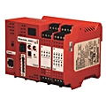
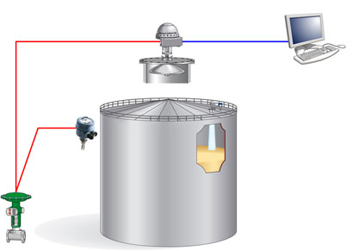

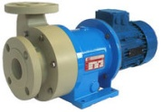
overfill protection vessel
DCS
Example:
add. overfill protection on an oil tank
Safety switch off in case of overflow
de-energise to safe, to stop the oil inflow
Safe switch on the pump (energise to safe) discharge oil until the normal level is reached
Cable break / open wire or short circuit will be not detected!
pump
overflow tank
additional line & load
monitoring function needed!
valve
signal from field / monitoring signal
safety related signal
Test signal

